Slide 1


Creative Powerpoint
Template by HubSpot
01

Slide 2

How to Use This Template:
Thanks for downloading this resource.
Use this presentation as a guide/inspiration for your own PowerPoints. Format the presentation using your brand’s colors, fonts, images, and style.
Add new slides using the “New Slide” button in the toolbar.
These templates are for both Mac and PC users, but if anything shows up a little funky or misaligned, just adjust to the slide and shift around anything that may appear different.
Use the elements you need. If you like a text box or layout from one slide, copy & paste it onto another and mix and match designs.
Notes:
Please watch all videos above.

Slide 3

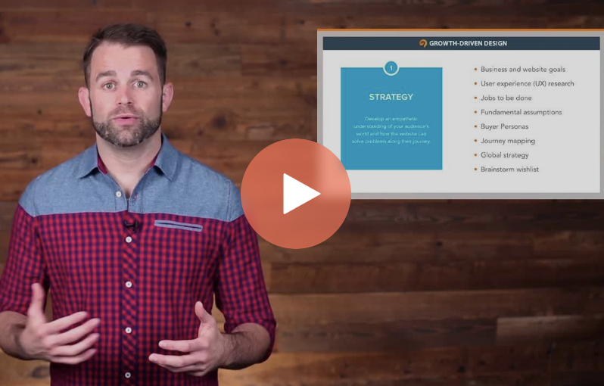
Sharpen your skills
With HubSpot Academy
Take free courses on Inbound Marketing, Sales, and Customer Service
Visit https://bit.ly/3auUHUl to Get Started Free
Notes:
Product Screenshot Full MacBook

Slide 4

Presentation Best Practices
Use this presentation as a guide/inspiration for your own PowerPoints. Format the presentation using your brand’s colors, fonts, images, and style.
Add new slides using the “New Slide” button in the toolbar.
These templates are for both Mac and PC users, but if anything shows up a little funky or misaligned, just adjust to the slide and shift around anything that may appear different.
Use the elements you need. If you like a text box or layout from one slide, copy & paste it onto another and mix and match designs.
02

Slide 5


Nice to meet you.
Name: Expert Eduardo
Title: Chief Engineering Officer, Our Brand
Twitter: @EngineerEduardo
03

Slide 6


Agenda
Introductions
Q1 Recap Creative Brainstorming Strategy Discussion
Review & Assign Deliverables

Slide 7


Section Title

Slide 8
Introductions
Start the meeting off strong with personal intros.
Incorporate bullet points to break up slides
Leave plenty of white space
Leverage bold and italics to emphasize points
06

Slide 9

Use photography to create a visually dynamic and interesting presentation. Try websites like Unsplash.com or the free stock photos in HubSpot’s Marketing Hub.

Slide 10

“Either write something worth reading or do something worth writing about.”
Benjamin Franklin, a Founding Father of the United States

Slide 11

47%
of buyers view at least
3 to 5 pieces of content before deciding to speak with a sales rep.
Source: Demand Gen Report, 2016
09

Slide 12
Brands Turn to Video for Content Marketing
Source: HubSpot

Slide 13
Thank You!

Slide 14

Grow your traffic, convert leads, and prove ROI with our all-in-one marketing software.
Visit bit.ly/2zfjZD4 for
a free demo

